Slide 1
Best Practices for Creating a Position Description and The Importance of Updated PDs
Brooke Aiken, Section 508 Program Manager
Earl McJett, Sr. Information Management Analyst
June 30, 2020

Slide 2


Who Are We?
Brooke Aiken,
FDIC Section 508 Program Manager
Earl McJett, former FDIC Section 508 Coordinator

Slide 3

Earl’s Journey to 508
Hired as a Litigation Paralegal
Worked in Minority- and Women-Owned Law Firm Outreach
Advocated for minorities, women, people over 40 and individuals with disabilities.
Gained expertise in HTML, data, reporting, etc.
Served in various IT governance roles.

Slide 4

Creation of the FDIC’s Section 508 Coordinator Role
Meeting to determine where the program should reside
Initial decision based on who already had the unique set of required skills

Slide 5
Evolution of the FDIC’s Section 508 Coordinator Role
1998
2000
2001
2013
Jan 18, 2017
Amendments to Section 508 of the Rehabilitation Act of 1973
Technical Standards published in the Federal Register
Technical Standards became effective
OMB Section 508 Strategic Plan
Refreshed Section 508 Technical Standards
Events triggered a rethinking of the Section 508 program leadership role
1998 – General Counsel reviews the legal requirements
2000 – General Counsel reviews the regulatory requirements
2001 – FDIC assigns Section 508 Coordinator duties to ODEO
2013 – FDIC increases contractor support and adopts Trusted Tester methodology
2017 – FDIC decides to create full time Section 508 Program Manager

Slide 6
Section 508 Coordinator to Section 508 Program Manager
August 2019
Section 508 Coordinator
Section 508 Program Manager

Slide 7
Section 508 Program Manager Position Approval
Process took approximately 2 years
Refreshed standards required updates to the 508 program
Comprehensive rewrite of the FDIC Section 508 policy directive
Update to the Trusted Tester program
Increased usage of Agile software development methodology
New full time 508 Program Manager position created
508 Program Manager position description developed

Slide 8
Section 508 Program Manager Position Description
Modeled after:
Play 1 in the Section 508 Playbook https://www.section508.gov/tools/playbooks/technology-accessibility-playbook-intro/play01
Section 508 Leadership Core Competency Model https://www.section508.gov/sites/default/files/508_Leadership_Core_Competency_Model.pdf

Slide 9
Developing a Full Time Program
Support- What can you leverage?
Contractor Support
Feds
Interns
What is important to your Agency?
Document Compliance
Captioning
OMB Self Assessment Survey
What is important to you (when developing your program)
Taking care of our customers
Testing
Training
Networking
Chief Web Officer
CIO
EEO/CRCL

Slide 10
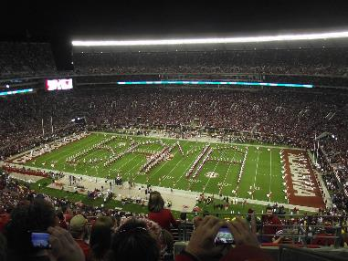
If You Build It…..They Will Come
We are past “It’s a Law”
Listen to your Customers
Don’t be Silenced
What do you need to make the program better?
People
Tools
Education
Partnership with other agencies?

Slide 11

Section 508 Community
How can we help you?
Lean on others within the Section 508 Community
Do not create a program in a vacuum
Use your resources
You are not in this alone!
Contact Us
Brooke Aiken
Braiken@fdic.gov or Section508@fdic.gov
Earl McJett
EMcJett@fdic.gov

